Slide 1
CSGY-6513-C, BIG DATA SPRING 26
FINAL PROJECT
US Traffic Accident Severity & Risk Modeling
Ananya Nadig an4968
Isha Jariwala ij2221
Rhea Shastri rs9459

Slide 2
Contents
Project Overview
Objectives
Dataset Overview
Data pipeline
Exploratory Data Analysis (EDA)
SSRI Analysis
Machine Learning Models
Feature Importance
Results
Challenges faced
Future Work/ Improvements

Slide 3
Project Overview
Problem statement:
Road traffic accidents are a major public safety concern
Large-scale datasets (millions of records) make analysis challenging
Accident severity depends on multiple interacting factors (time, weather, location)
Traditional methods fail to capture complex patterns at scale
Approach:
Used PySpark for scalable, distributed data processing
Performed data cleaning, preprocessing, and feature engineering
Conducted EDA to analyze severity trends across time and conditions
Built ML models (Logistic Regression, Random Forest) for prediction

Slide 4
Objectives
🔹 Data & Processing
Scalable distributed pipeline
Analyze severity trends (2016–2023)
🔹 Analysis
Environmental & temporal risk factors
Identify high-risk geographic regions
🔹 Modeling & Insights
Build ML models (LR, RF)
Develop SSRI for risk comparison
Interpret key risk factors

Slide 5
Dataset Overview
Dataset Name: US Accidents Dataset (2016–2023)
Source: Kaggle
Link: https://www.kaggle.com/datasets/sobhanmoosavi/us-accidents
Dataset File Size: 2-3 GB
Approximate Number of Records : 7+ million records
Project Subset: 3 million records sampling, sampled it down to 20%.
Geographic Coverage: 49 US states

Slide 6
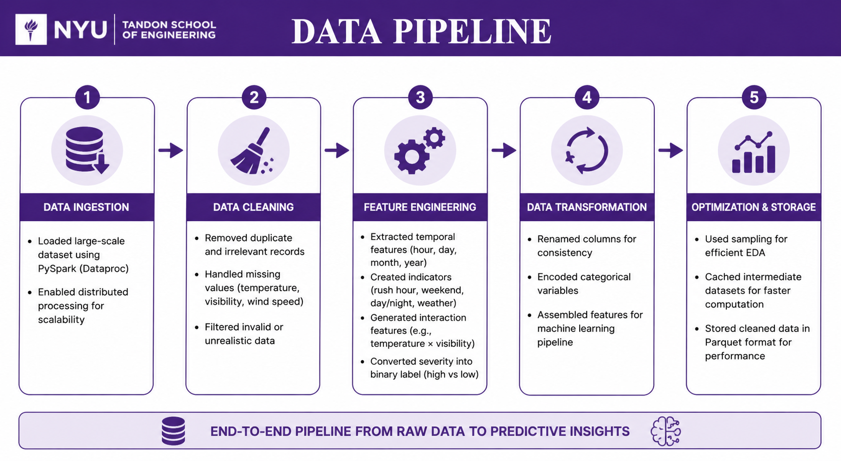
Data Pipeline

Slide 7
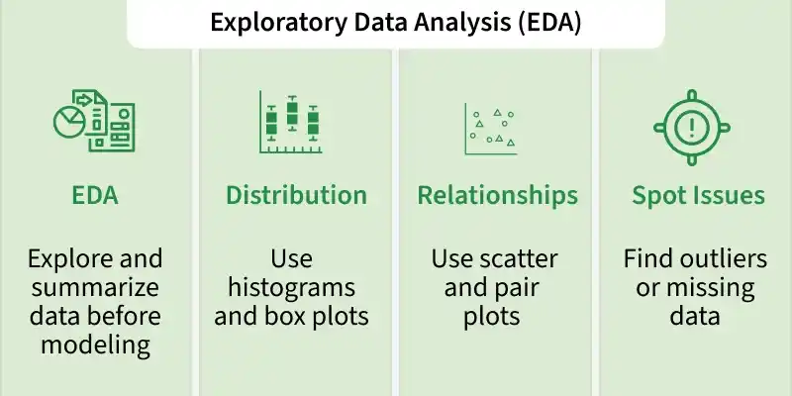
EDA
What we did:
Analyzed dataset structure (~3M records)
Studied severity distribution → identified class imbalance
Explored time patterns (hour, day/night, monthly trends)
Examined weather & environmental factors (visibility, temperature, weather conditions)
Performed geographic analysis (state & city-level accident hotspots)
Analyzed road infrastructure (junctions, traffic signals, crossings)
Studied feature relationships with severity
Checked data quality & outliers
Key Insights:
Severe accidents are less frequent → class imbalance
Low visibility & bad weather → higher severity
Peak hours → more accidents
Certain cities & states → high-risk zones

Slide 8
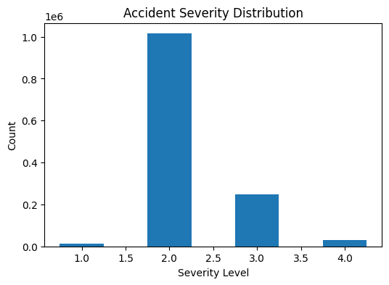
VISUALIZATION: SEVERITY DISTRIBUTION
Key Insights:
Distribution is heavily skewed toward Severity 2, showing most accidents are non-critical.
Severe accidents (3 & 4) are rare, making prediction more challenging.
Indicates need for imbalance handling techniques in machine learning models.

Slide 9
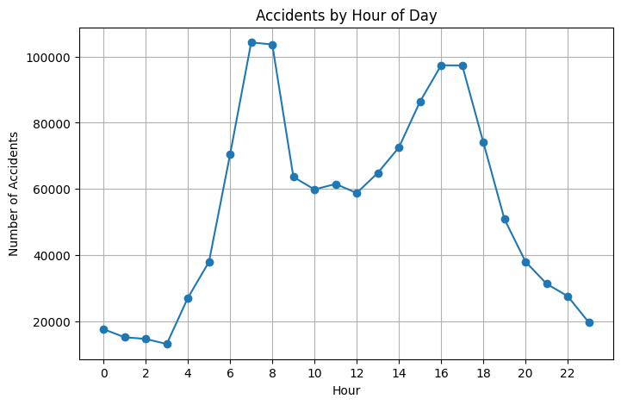
VISUALIZATION: ACCIDENTS BY HOUR
Key Insights:
Clear bimodal pattern with peaks during morning (7–9 AM) and evening (4–6 PM) rush hours.
Evening peak is broader, indicating extended congestion and higher sustained risk.
Lowest accident frequency during late night (1–4 AM) due to minimal traffic.
Time of day is a strong factor influencing accident occurrence, closely linked to traffic density.

Slide 10
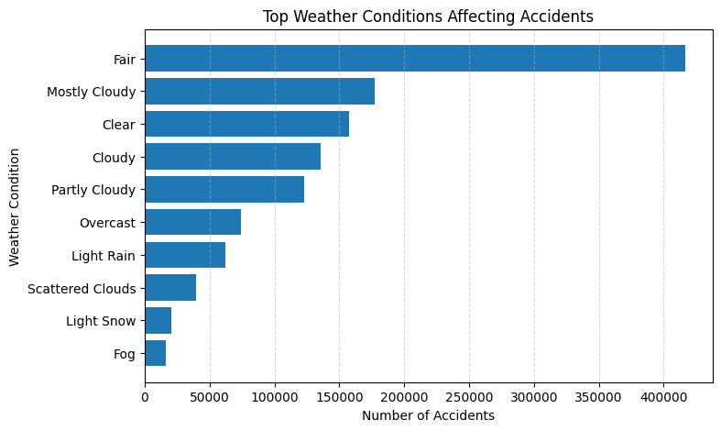
VISUALIZATION: WEATHER CONDITIONS
Key Insights:
Accident distribution is heavily skewed toward non-extreme weather conditions.
High counts in “Fair” weather suggest exposure effect (more vehicles on road).
Severe weather events are less frequent but potentially higher risk per incident.
Indicates need to focus on traffic patterns alongside environmental factors.

Slide 11
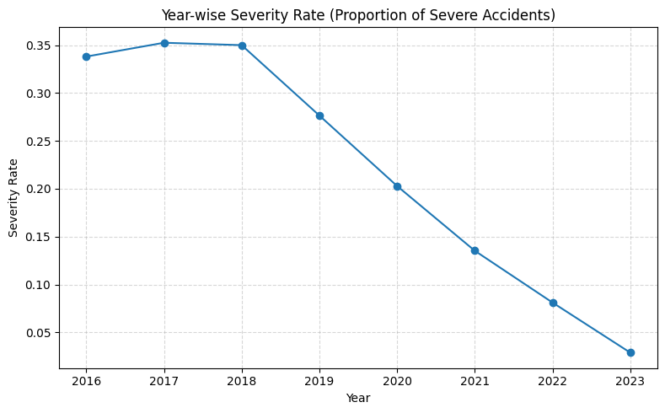
VISUALIZATION: SEVERITY TREND
Key Insights:
Severity rate shows a clear declining trend from 2018 to 2023.
Peak severity observed around 2017–2018, followed by a steady drop.
Significant reduction post-2020, possibly due to changes in traffic patterns and mobility (post-pandemic effects).
Indicates improvements in road safety, awareness, or emergency response systems over time.
Lower severity rate suggests fewer high-impact accidents relative to total accidents.

Slide 12
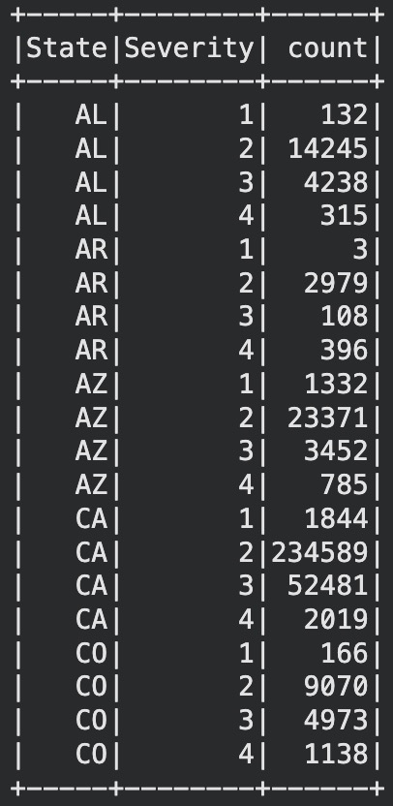
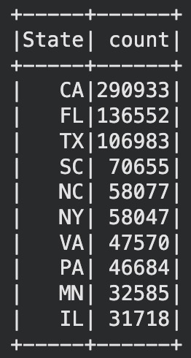
HIGH RISK GEOGRAPHICAL TREND
High Accident Volume (Counts)
States like CA, FL, TX have the highest accident counts
Driven by high traffic volume and population density
Reflects frequency, not necessarily severity
Severity Distribution (Per State)
Shows breakdown of accidents by severity levels (1–4)
Some states have a higher proportion of severe cases (3 & 4)
Used to compute SSRI for normalized risk comparison

Slide 13
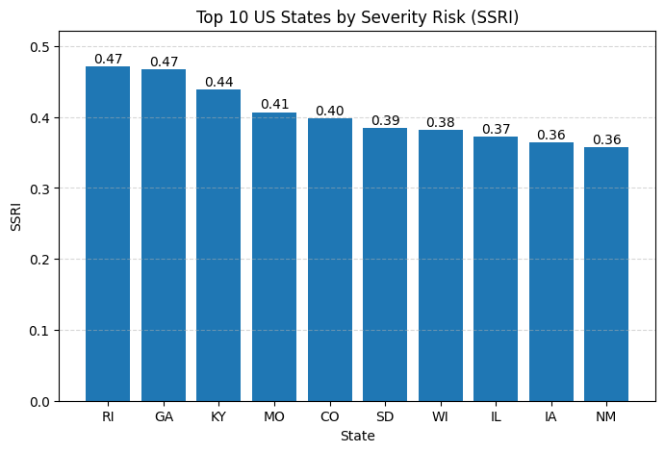
SSRI ANALYSIS
State Severity Risk Index (SSRI):
Measures proportion of high-severity accidents (≥ 3) across states.
Provides a normalized risk metric, not just raw accident counts.
States like RI and GA show highest severity risk (~0.47).
Reveals true high-risk states independent of traffic volume.
Variation across states (~0.36–0.47) shows meaningful geographic differences.
Indicates influence of road conditions, speed limits, and driver behavior.
Some states with fewer accidents still show higher severity risk (hidden hotspots).
Useful for targeted safety planning and policy decisions.

Slide 14
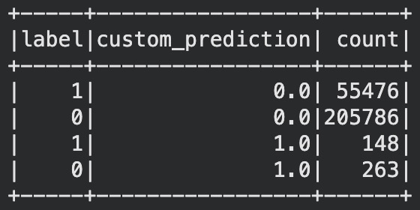
MACHINE LEARNING MODELS
Logistic Regression - Baseline
Used as an interpretable baseline model
Predicts probability of high-severity accidents
Helps understand how features influence severity risk
Baseline Issue
Dataset is imbalanced: low-severity accidents dominate
Baseline model predicted most cases as low severity
Severe-accident recall was very low
Imbalance Handling
1:1 downsampling
2:1 downsampling
Class weighting
Figure. Confusion Matrix for LR - Baseline Model
Takeaway
Class imbalance caused poor severe-accident detection, so balancing strategies were needed to improve recall.

Slide 15
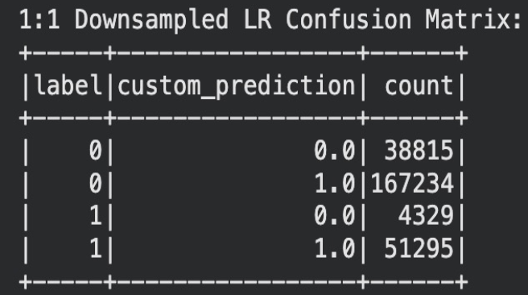
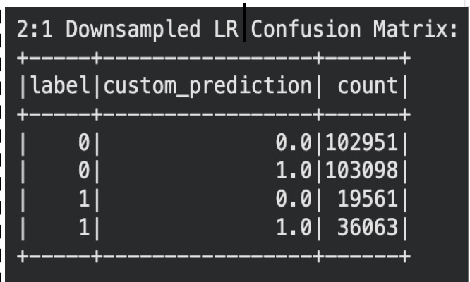
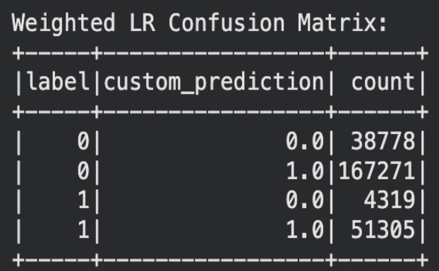
MACHINE LEARNING MODELS
Logistic Regression Performance: Confusion Matrix
1:1 Downsampling | 2:1 Downsampling | Class Weighting
High recall (~90%+) Lower precision (more false positives) | More balanced precision & recall | Similar to 1:1 but keeps full data

Slide 16
MACHINE LEARNING MODELS
Logistic Regression Insights
Best at detecting severe accidents (high recall)
Over-predicts severe cases → many false positives
Good for risk-sensitive applications
Takeaway: Strong detection model, but not balanced.
While Logistic Regression improved detection of severe accidents, it produced many false positives. To achieve a better balance, we evaluated a more powerful model: Random Forest.

Slide 17
MACHINE LEARNING MODELS-RANDOM FOREST
Why Random Forest?
Model Inference
Handles non-linearity
Captures complex patterns that Logistic Regression cannot model
- 30 trees, tuned max depth & bins
- Trained on full data + 1:1 downsampled variant
- Custom threshold on prob_array[1] > 0.5
- Full data variant uses class weighting (weightCol) to handle imbalance
Ensemble approach
Combines 30 decision trees → reduces overfitting and variance
Imbalance-aware
More robust to class imbalance than a linear baseline model
Variants Trained
RF full data + class weights
RF 1:1 Downsampled
Custom threshold
Random Forest delivers the best overall performance — higher F1 (0.397), better AUC (0.644), and a stronger precision-recall balance than any Logistic Regression variant, making it the preferred model for severe accident detection.

Slide 18
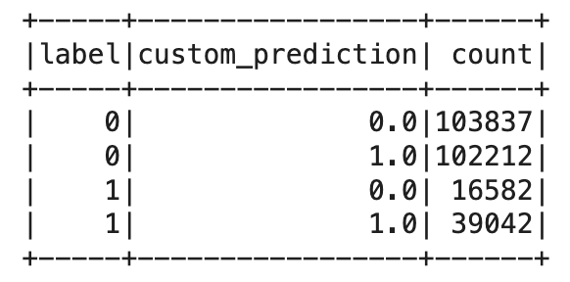
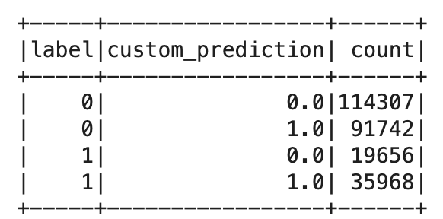
MACHINE LEARNING MODELS-RANDOM FOREST
Random Forest(Base)
30 trees · maxDepth 8 · threshold 0.5 · weightCol applied to handle imbalance
Random Forest(Balanced)
30 trees · maxDepth 8 · threshold 0.5 · no weightCol · balanced training set
Confusion matrix
Confusion matrix
0.644
AUC
0.702
Recall
0.397
F1 Score
0.276
Precision
0.645
AUC
0.647
Recall
0.392
F1 Score
0.282
Precision
WHAT THIS TELL US
70% of severe accidents caught — class weighting pushes the model to prioritize the minority class
High false positives (102K) reflect the precision-recall tradeoff — model flags many non-severe cases as severe
Only 16,582 severe cases missed — lowest FN across both RF variants, best for safety-critical use
WHAT THIS TELL US
Fewer false alarms (91K FP) — balancing training data makes predictions more conservative
Slightly better precision (0.282) — when it predicts severe, it is more often correct
Misses 3,074 more severe cases than base RF — higher FN is a safety concern for this use case

Slide 19
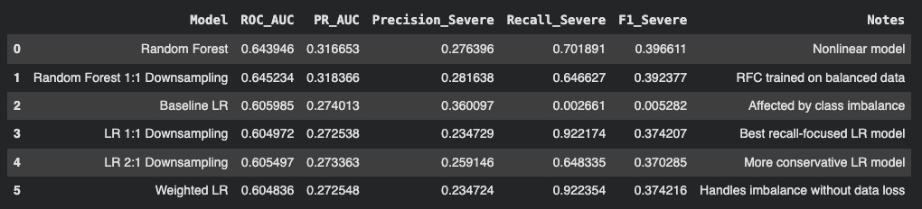
MODEL COMPARISON
Comparison between Logistic Regression and Random Forest across multiple imbalance-handling strategies.

Slide 20
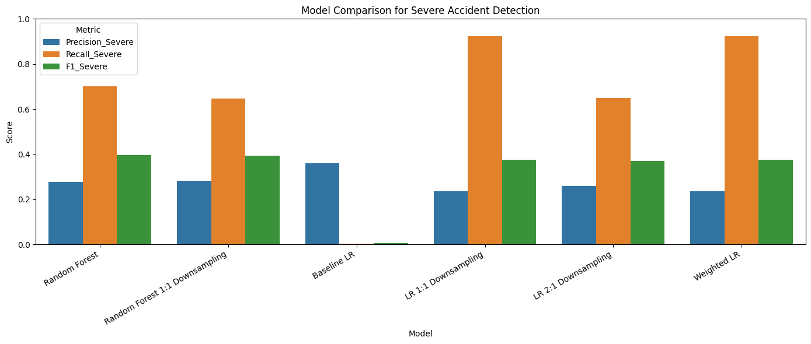
MODEL COMPARISON
Chart compares Precision, Recall, and F1 Score for severe accidents.

Slide 21
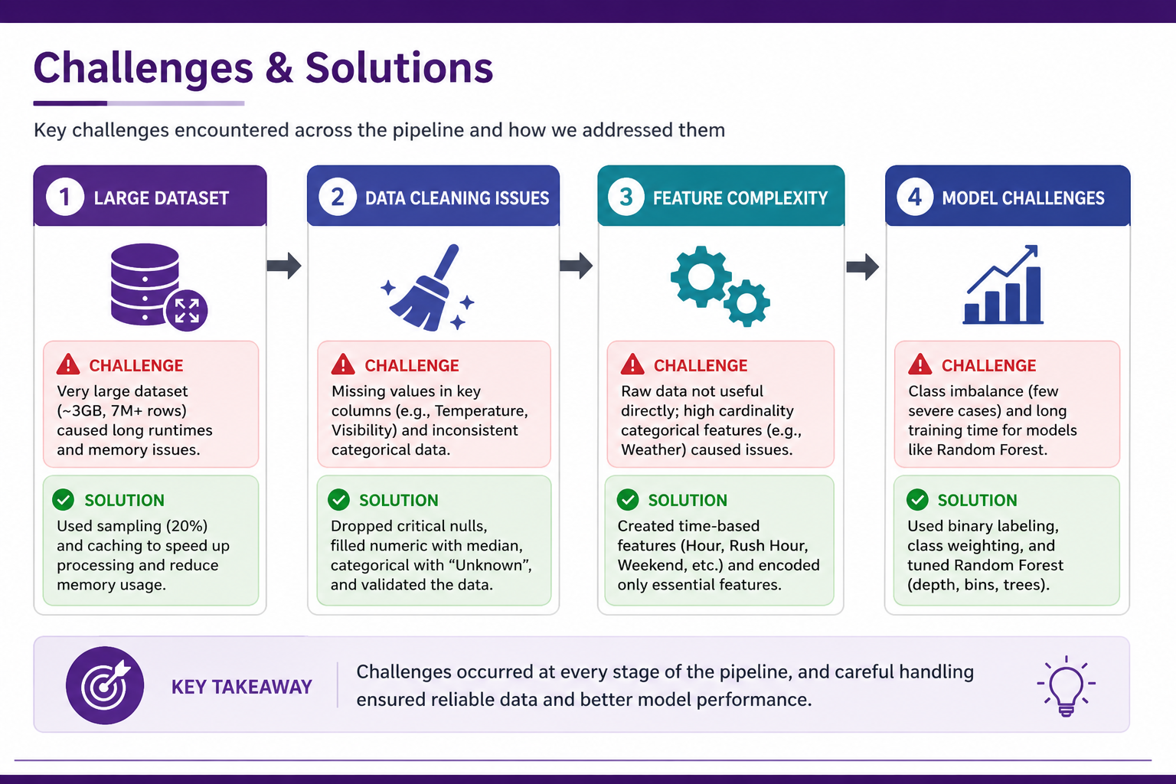
CHALLENGES FACED

Slide 22
FUTURE WORK AND IMPROVEMENTS
Real-Time Data Integration: Incorporating live traffic and weather data will enable dynamic and timely risk prediction, allowing the model to adapt to changing road conditions.
Enhanced Feature Set: Including additional factors such as traffic volume, road type, and driver behavior will provide deeper context and improve overall model accuracy.
Advanced Modeling Techniques: Applying models like XGBoost and Deep Learning can capture complex, non-linear relationships that traditional models may miss.
Handling Class Imbalance: Using techniques such as SMOTE and advanced resampling will improve the model’s ability to detect rare but critical high-severity accidents.
Interactive Dashboard Development: Developing a user-friendly dashboard will help visualize trends and support decision-making for stakeholders and policymakers.
Fine-Grained Risk Prediction: Extending the analysis to city-level and route-level predictions will enable more localized, targeted safety interventions.

Slide 23
CONCLUSION
Scalable Processing Built a distributed pipeline using PySpark for large-scale data analysis.
Key Insights Identified impact of time, weather, and location on accident severity.
Model Comparison Random Forest outperformed Logistic Regression in capturing complex patterns.
Key Contribution Developed SSRI for normalized comparison of severity risk across states.
We successfully met all the objectives outlined in our proposal, from building a scalable pipeline to developing SSRI and comparing machine learning models.

Slide 24


THANK YOU!

